Slide 1
THANK YOU
NORTH GEORGIA
TECH

Slide 2
SkillsUSA
Georgia
2024 Region 2 Winners

Slide 3
Advertising
Design

Slide 4
1^{st :} Alan Garcia Marban
R.W. Johnson High School
2^{nd :} Ayelet Flores
Flowery Branch High School
3^{rd :} Jabari Morrison
Shiloh High School

Slide 5
Automotive
Refinishing
Technology

Slide 6
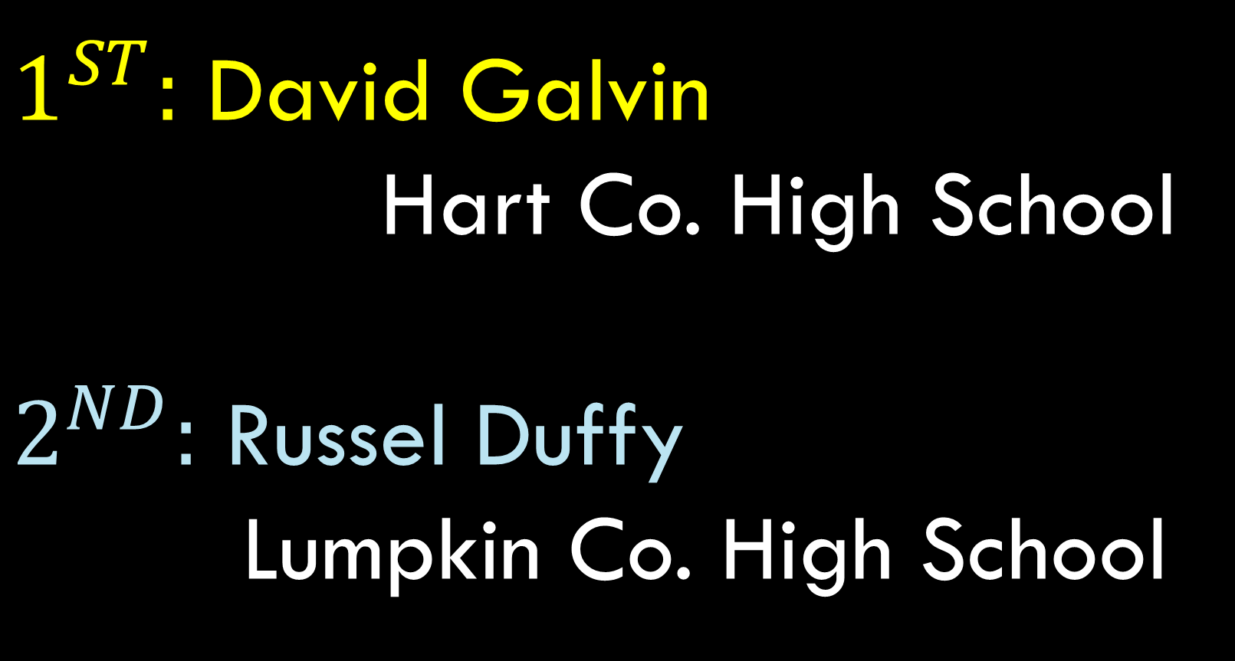

Slide 7
Automotive
Service
Technology

Slide 8
1^{st :} Isaac Kellerman
Franklin County High School
2^{nd :} Cru Norton
Lumpkin County High School
3^{rd :} Neil Register
Cedar Shoals High School

Slide 9
Cabinet
Making

Slide 10
1^{st :} Hayden McKenzie
Lumpkin County High School
2^{nd :} Kaycie Smith
West Hall High School
3^{rd :} Logan Thornton
Union County High School

Slide 11
Cosmetology

Slide 12
1^{st :} Rylee Whitmer
Forsyth Central High School
2^{nd :} Jaretzy Lugarda Ramirez
Maxwell High School
3^{rd :} Katlyn Elrod
Stephens County High School

Slide 13
Esthetics

Slide 14
1^{st :} Emma Dear
West Forsyth High School
2^{nd :} Ana Wooten
Forsyth Central High School
3^{rd :} Jada Nesbitt
Stephens County High School

Slide 15
Extemporaneous
Speaking

Slide 16
1^{st :} Sanaai Drayton
Alliance Academy of Innovation
2^{nd :} Afomia Giday
South Gwinnett
3^{rd :} Barrett Wilkinson
Lumpkin County High School

Slide 17
First Aid/
CPR

Slide 18
1^{st :} Maya Gasky
R.W. Johnson High School;
2^{nd :} Ari Carter
Shiloh High School
3^{rd :} Joshua Haynes
Hart County High School

Slide 19
Job
Interview

Slide 20
1^{st :} David Mendoza
R.W. Johnson High School
2^{nd :} Nymisha Vitta
South Forsyth High School
3^{rd :} Victoria Frank
Dawson County High School

Slide 21
Job Skill
Demonstration A

Slide 22
1^{st :} Camila De Oleo
Flowery Branch High School
2^{nd :} Ellie Doan
Stephens County High School
3^{rd :} Sofia Comegilio
Empower College & Career Academy

Slide 23
Job Skill
Demonstration
Open

Slide 24
1^{st :} Anita Yasini
Maxwell High School
2^{nd :} Caitlin Hendrix
Stephens County High School
3^{rd :} Anabelle Thomas
White County High School

Slide 25
Pin
Design

Slide 26
1^{st :} Anna Turpin
Flowery Branch High School
2^{nd :} Ashley Castillo
West Hall High School
3^{rd :} Jasmin Caceres
Maxwell High School

Slide 27
Prepared
Speech

Slide 28
1^{st :} Kevin Matute-Mojica
Meadowcreek High School
2^{nd :} Bricen Popko
Lumpkin County High School
3^{rd :} Isabella Rappaccioli
Alliance Academy of Innovation

Slide 29
Quiz Bowl

Slide 30
1^{st :} Lumpkin County High School
2^{nd :} Alliance High School
3^{rd :} East Hall High School

Slide 31
T-Shirt
Design

Slide 32
1^{st :} Sophia Herrera
West Hall High School
2^{nd :} Melany Fernandex Martinex
Apalachee High School
3^{rd :} Spencer Tarver
Forsyth Central High School

