Slide 1
New Advisor Training
Michelle Martinez

Slide 2
Welcome! Housekeeping…
While waiting for everyone to log in, please:
If you are a brand-new school (new to SkillsUSA), please submit a new school request (link will be in chat)
Ensure that you have a SkillsUSA account: skillsusa-register.org (will also add to chat)
Bookmark the following pages:
skillsusa.org
skillsusageorgia.org

Slide 3
What is SkillsUSA?

Slide 4
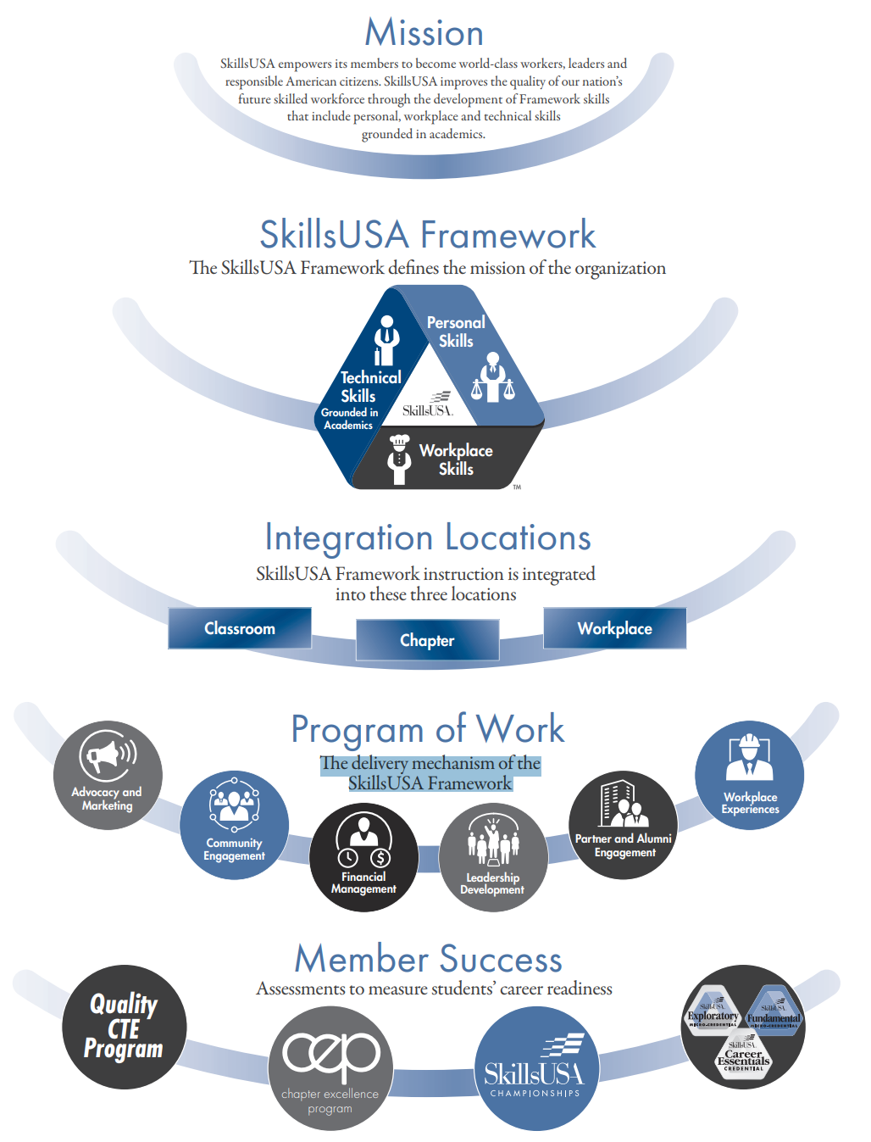

Slide 5
SkillsUSA Mission: The Why

Slide 6
SkillsUSA Framework: defines the mission

Slide 7
Integration Locations: The Where

Slide 8
SkillsUSA Program of Work: The How

Slide 9
Member Success: Measures Accomplishments

Slide 10
SkillsUSA is a solution

Slide 11
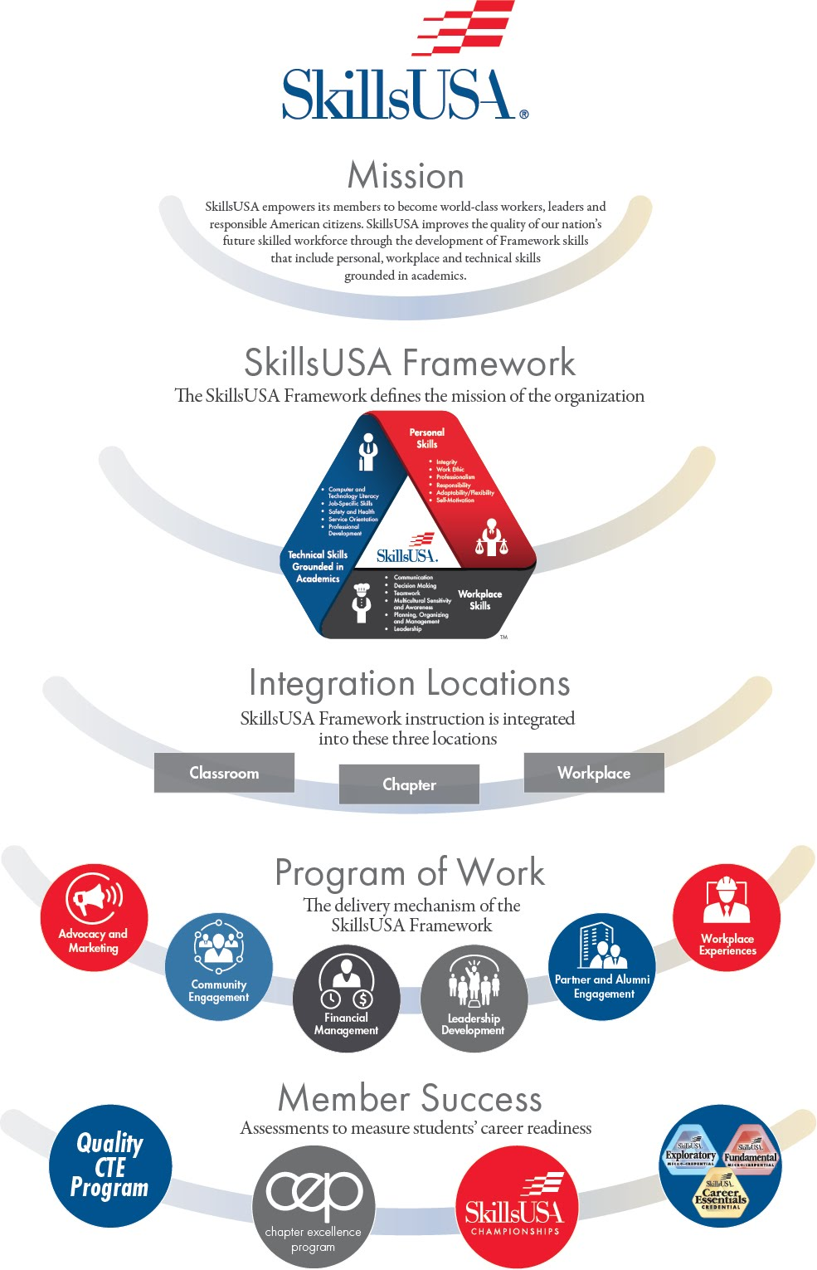

Slide 12
SkillsUSA Framework

Slide 13
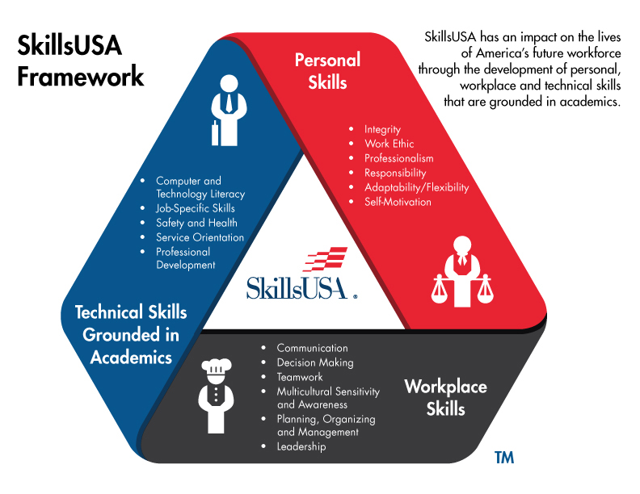

Slide 14
SkillsUSA Program of Work

Slide 15
SkillsUSA Program of Work

Slide 16
Helpful Resources

Slide 17
National Resources
National Website: skillsusa.org
Absorb
Professional Membership Benefits
Professional Development Calendar
Customer Care Team
State Website: skillsusageorgia.org

Slide 18
Body text here

Slide 19
Chapter Excellence Program Overview

Slide 20
Phases of the Chapter Excellence Program
Phase 1: Identifying the challenge.
Phase 2: Teaching the SkillsUSA Framework.
Phase 3: Teaching and assessing the needs of members.
Phase 4: Identifying targeted Essential Elements.

Slide 21
Phase 1: The Challenge
Employers today are calling for more emphasis on career readiness skills in addition to applied academics and technical skills.
Top career readiness skills employers are looking for (2019)
Communication
Leadership
Teamwork
Self-Motivation
Responsibility
Integrity
Decision Making
Problem Solving

Slide 22
Phase 2: Teaching the SkillsUSA Framework

Slide 23
Phase 3: Teaching and Assessing the Needs of Members

Slide 24
Phase 4: Identify the Targeted Essential Elements
Consider using the CEP Essential Element self-evaluation tool with all members.
Identify the Essential Elements your students’ data indicate they need support in developing.
Identify one target Essential Element within each component of the SkillsUSA Framework when possible.

Slide 25
Phase 5: Review and Evaluate Last Year’s Program of Work

Slide 26
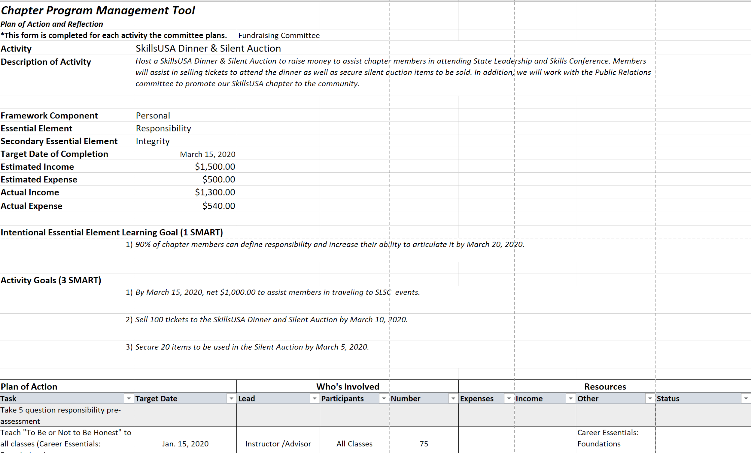
Phase 6: Develop a Program of Work for the Current Year

Slide 27
Phase 7: Write SMART Goals for Activities

Slide 28
Phase 8: Develop and Implement Project Management for each PoW Activity
Make a plan of action
What is the task to be completed?
What is the timeline?
Who is responsible?
What resources will be used?
What is the budget?

Slide 29
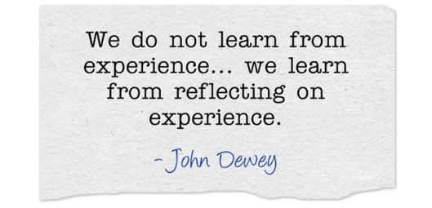
Phase 9: Evaluate Chapter and POW Activity Goal Achievement
Evaluate the SMART goal
Evaluate the impact

Slide 30
Phase 10: Celebrate the Success

Slide 31
Chapter Excellence Program

